Slide 1




Individual Fairness for Graph Neural Networks: A Ranking based Approach
Yushun Dong
University of Virginia
06/20/2021
06/20/2021
1
Individual Fairness for Graph Neural Networks: A Ranking based Approach
03/08/2021
Individual Fairness for Graph Neural Networks: A Ranking based Approach

Slide 2

Outline
Background Introduction
Previous Works
Existing Problems & Challenges
Our Solutions
Experiments & Conclusion
Future Works
06/20/2021
2
Individual Fairness for Graph Neural Networks: A Ranking based Approach
03/08/2021
Individual Fairness for Graph Neural Networks: A Ranking based Approach
Notes:
This is an outline of my today’s talk.
Firstly, I will give you a brief overview about the research I have presented in my proposal defense.
Next, I will talk about additional two pieces of work that I have done about some applications on attributed networks.
At last, I will give a summary about my dissertation research and vision about the future work.

Slide 3
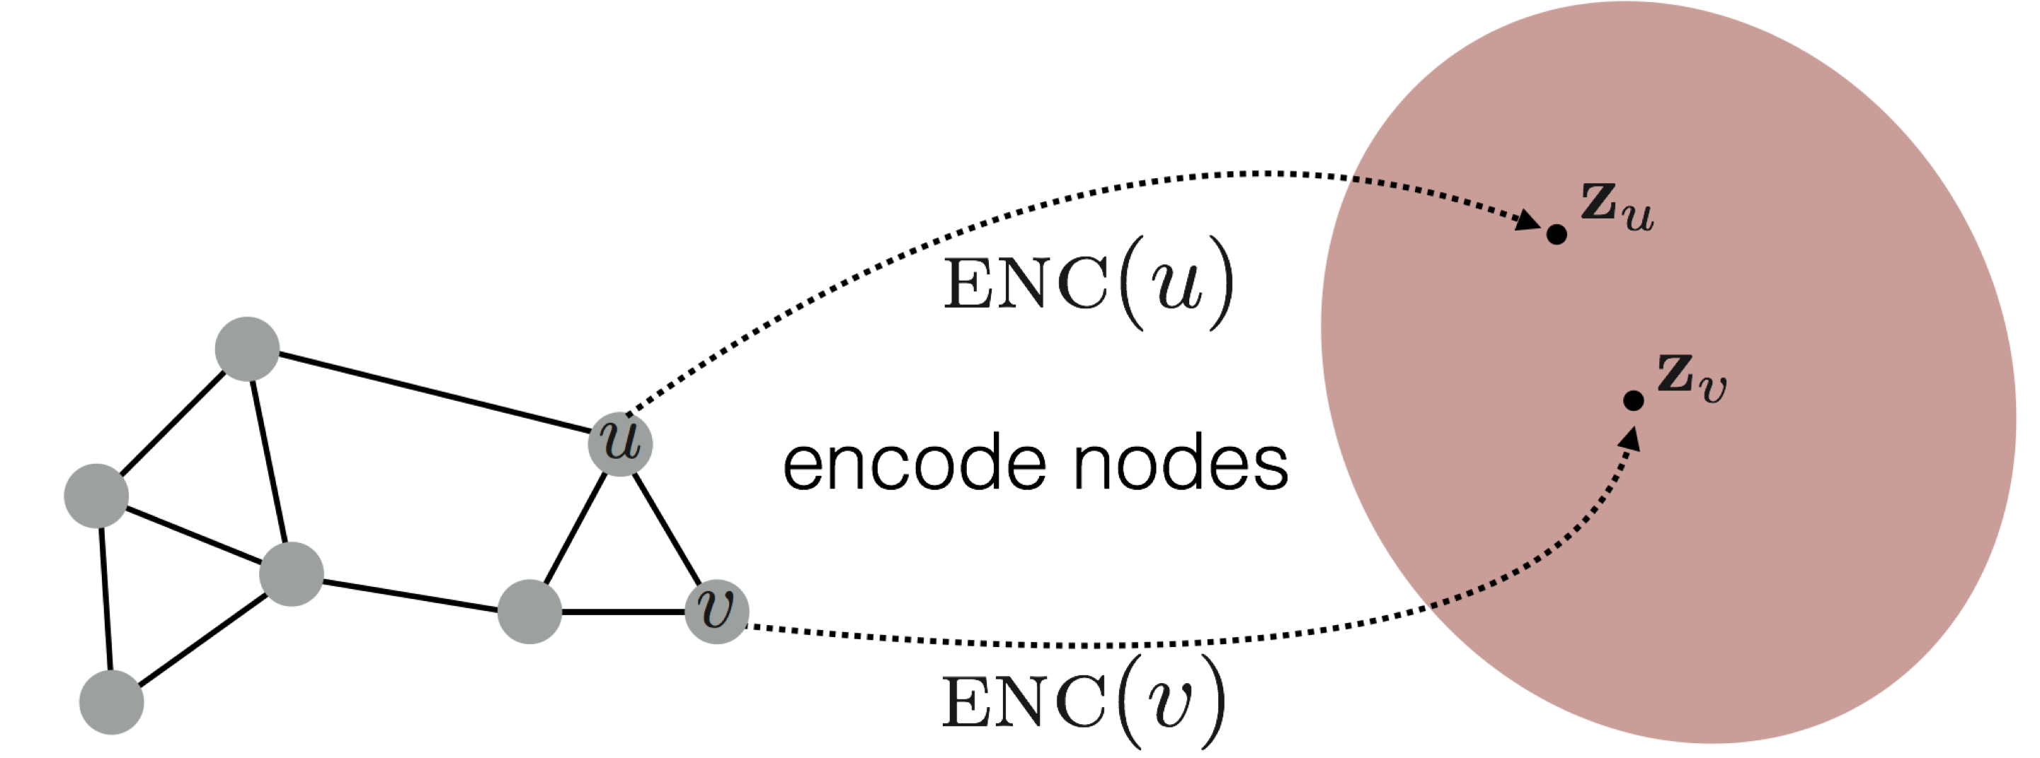

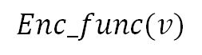
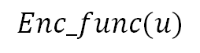
Background Introduction: Graph Neural Networks
Goal of Graph Neural Networks (GNNs): to encode nodes so that similarity in the embedding space (e.g., dot product) approximates similarity in the original network.
$$Enc_func(u)$$
$$Enc_func(v)$$
GNNs work here
Individual Fairness for Graph Neural Networks: A Ranking based Approach
06/20/2021
3
Notes:
This is an outline of my today’s talk.
Firstly, I will give you a brief overview about the research I have presented in my proposal defense.
Next, I will talk about additional two pieces of work that I have done about some applications on attributed networks.
At last, I will give a summary about my dissertation research and vision about the future work.

Slide 4
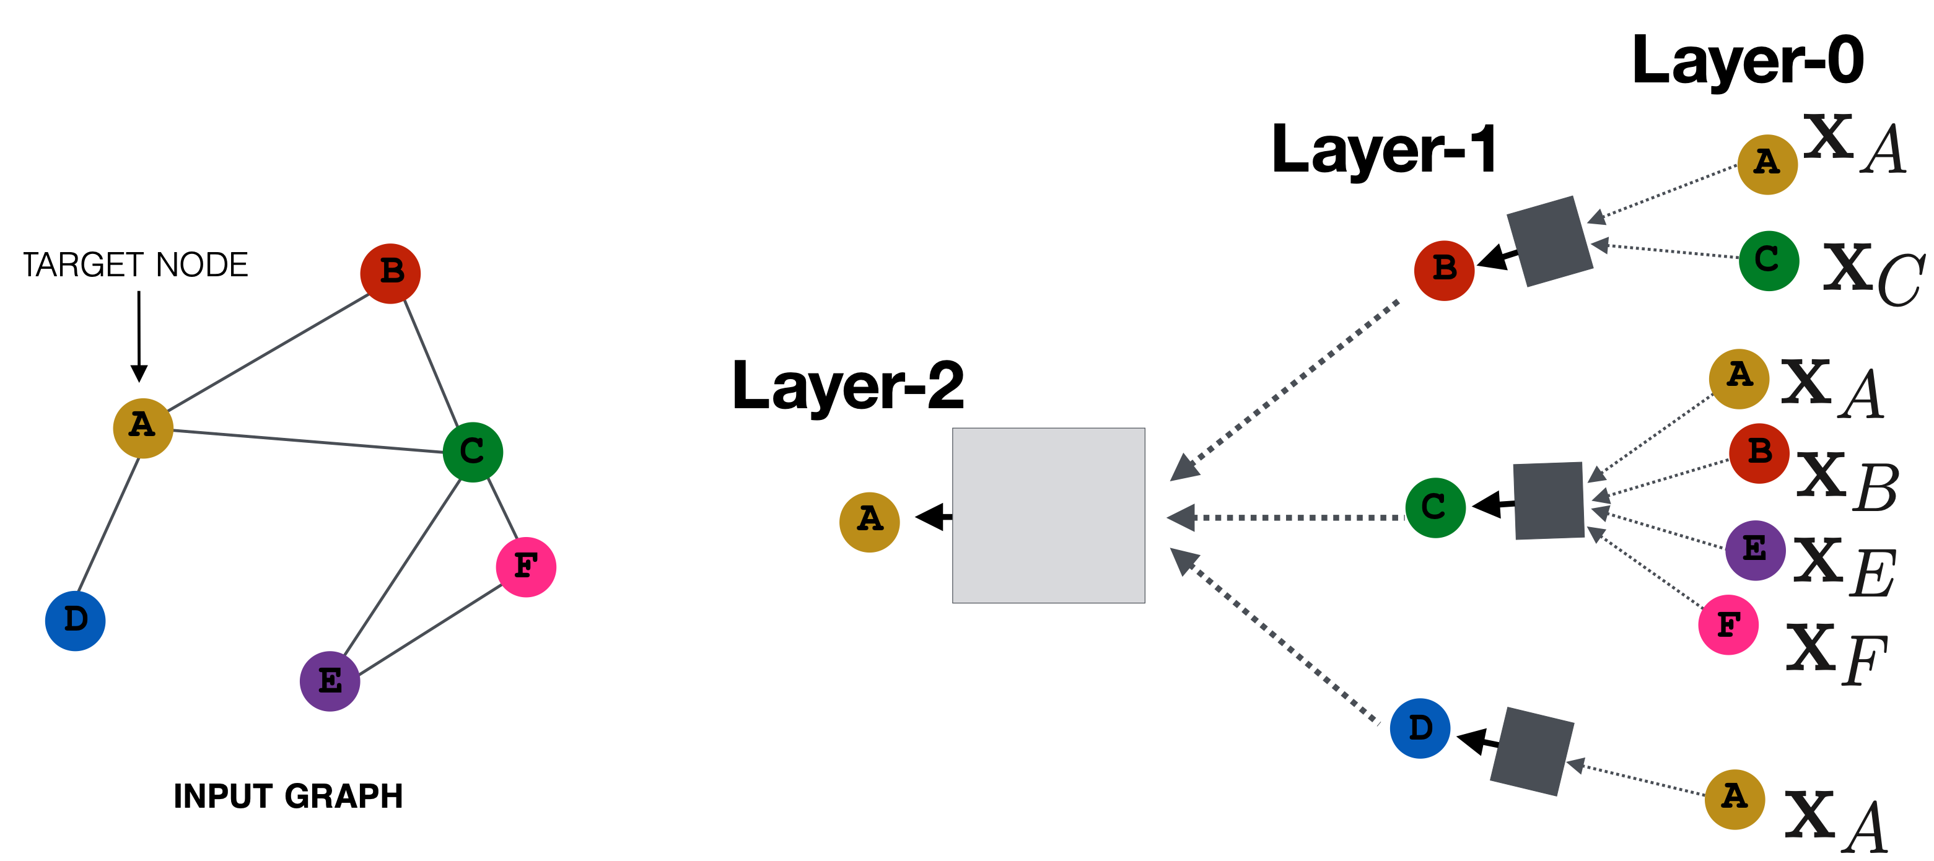
Background Introduction: Graph Neural Networks
Graph Neural Networks (GNNs) are models that capture the dependence of graphs via message passing between the nodes of graphs.
Neural network for better fitting ability
in GNNs
Message passing to capture dependence
Individual Fairness for Graph Neural Networks: A Ranking based Approach
06/20/2021
4
Notes:
This is an outline of my today’s talk.
Firstly, I will give you a brief overview about the research I have presented in my proposal defense.
Next, I will talk about additional two pieces of work that I have done about some applications on attributed networks.
At last, I will give a summary about my dissertation research and vision about the future work.

Slide 5
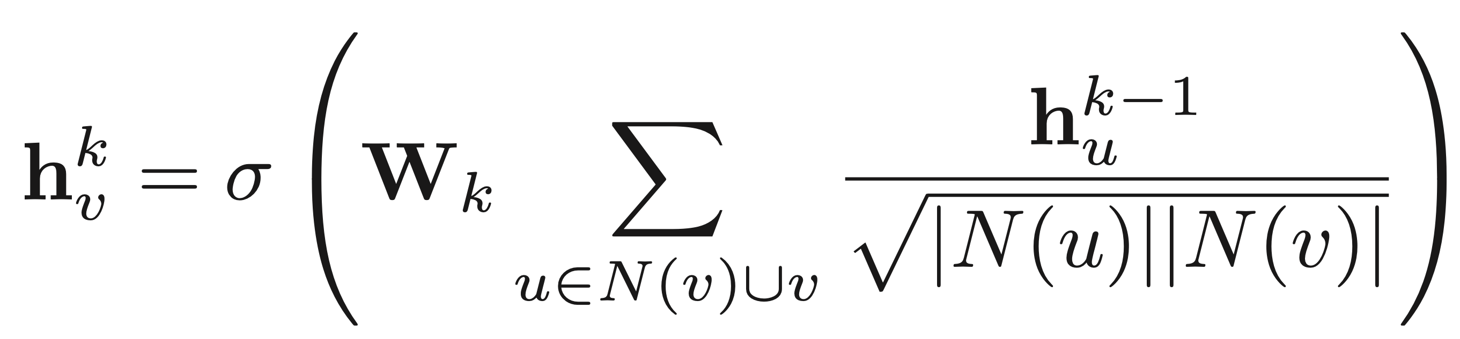
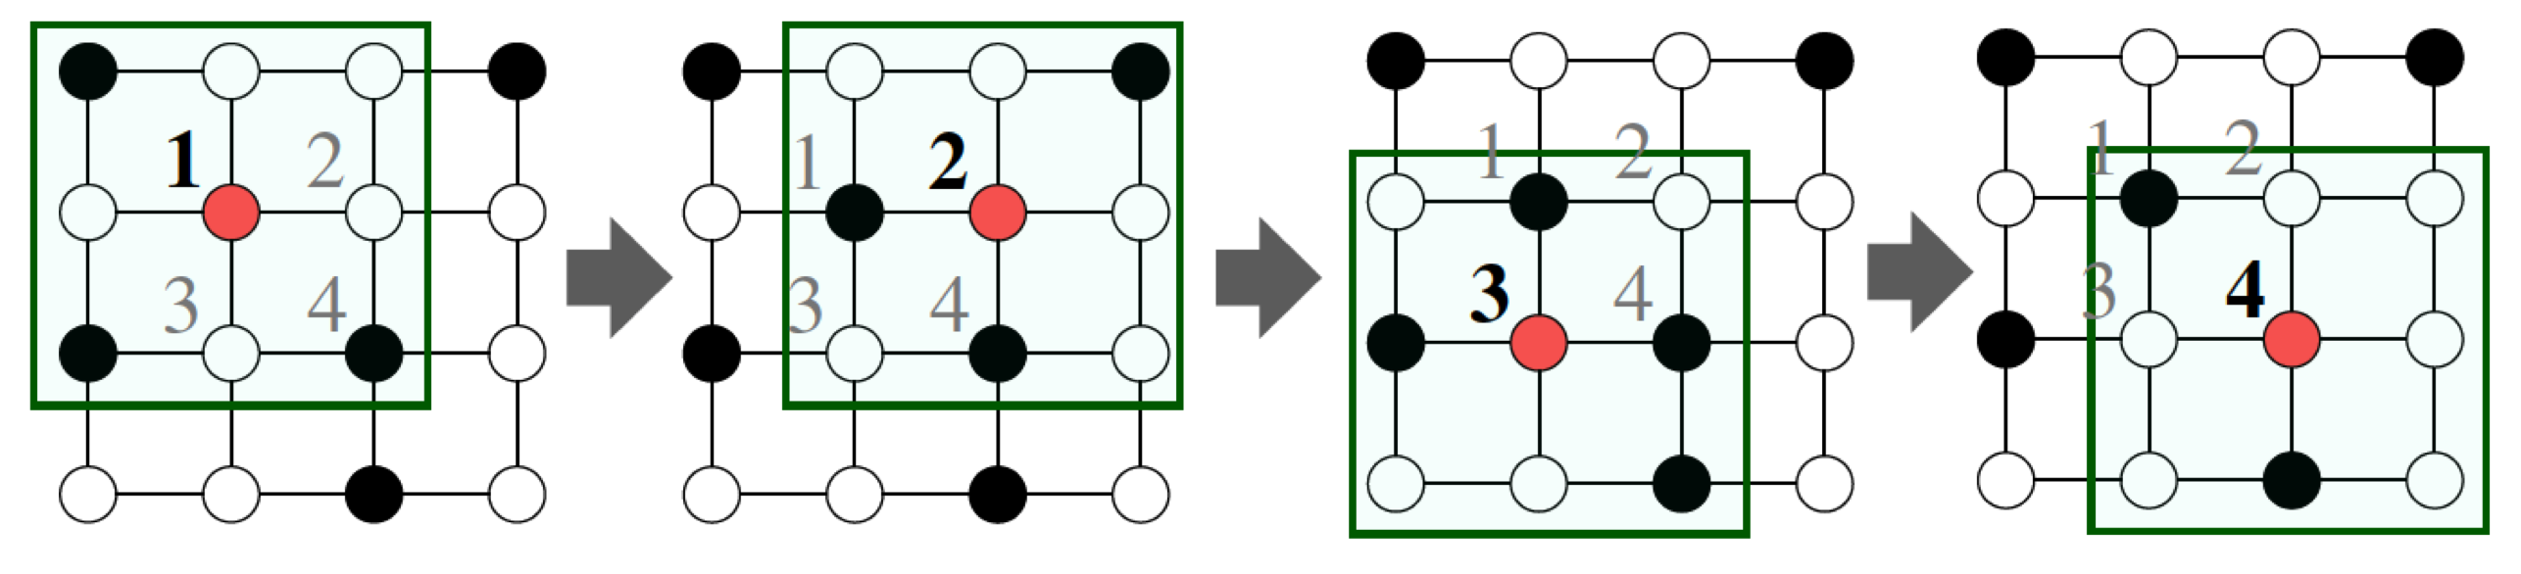
An Example: Graph Convolutional Networks
Graph Convolutional Network (GCN): Each node contributes information to the neighbor nodes.
Layer wise expression:
Neighborhood aggregation of GCN
06/20/2021
5
Individual Fairness for Graph Neural Networks: A Ranking based Approach
03/08/2021
Individual Fairness for Graph Neural Networks: A Ranking based Approach
Notes:
This is an outline of my today’s talk.
Firstly, I will give you a brief overview about the research I have presented in my proposal defense.
Next, I will talk about additional two pieces of work that I have done about some applications on attributed networks.
At last, I will give a summary about my dissertation research and vision about the future work.

Slide 6

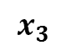
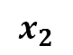
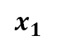
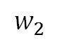
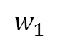
Background Introduction: Different Fairness Notions
Traditional GNNs usually lack fairness consideration.
Introducing different fairness notions to graphs and promoting fairness for GNNs become urgent needs.
So what are common fairness notions?
$$x_{1}$$
$$x_{3}$$
$$w_{2}$$
$$w_{1}$$
Fair Output?
$$x_{2}$$
06/20/2021
6
Individual Fairness for Graph Neural Networks: A Ranking based Approach
03/08/2021
Individual Fairness for Graph Neural Networks: A Ranking based Approach
Notes:
This is an outline of my today’s talk.
Firstly, I will give you a brief overview about the research I have presented in my proposal defense.
Next, I will talk about additional two pieces of work that I have done about some applications on attributed networks.
At last, I will give a summary about my dissertation research and vision about the future work.

Slide 7

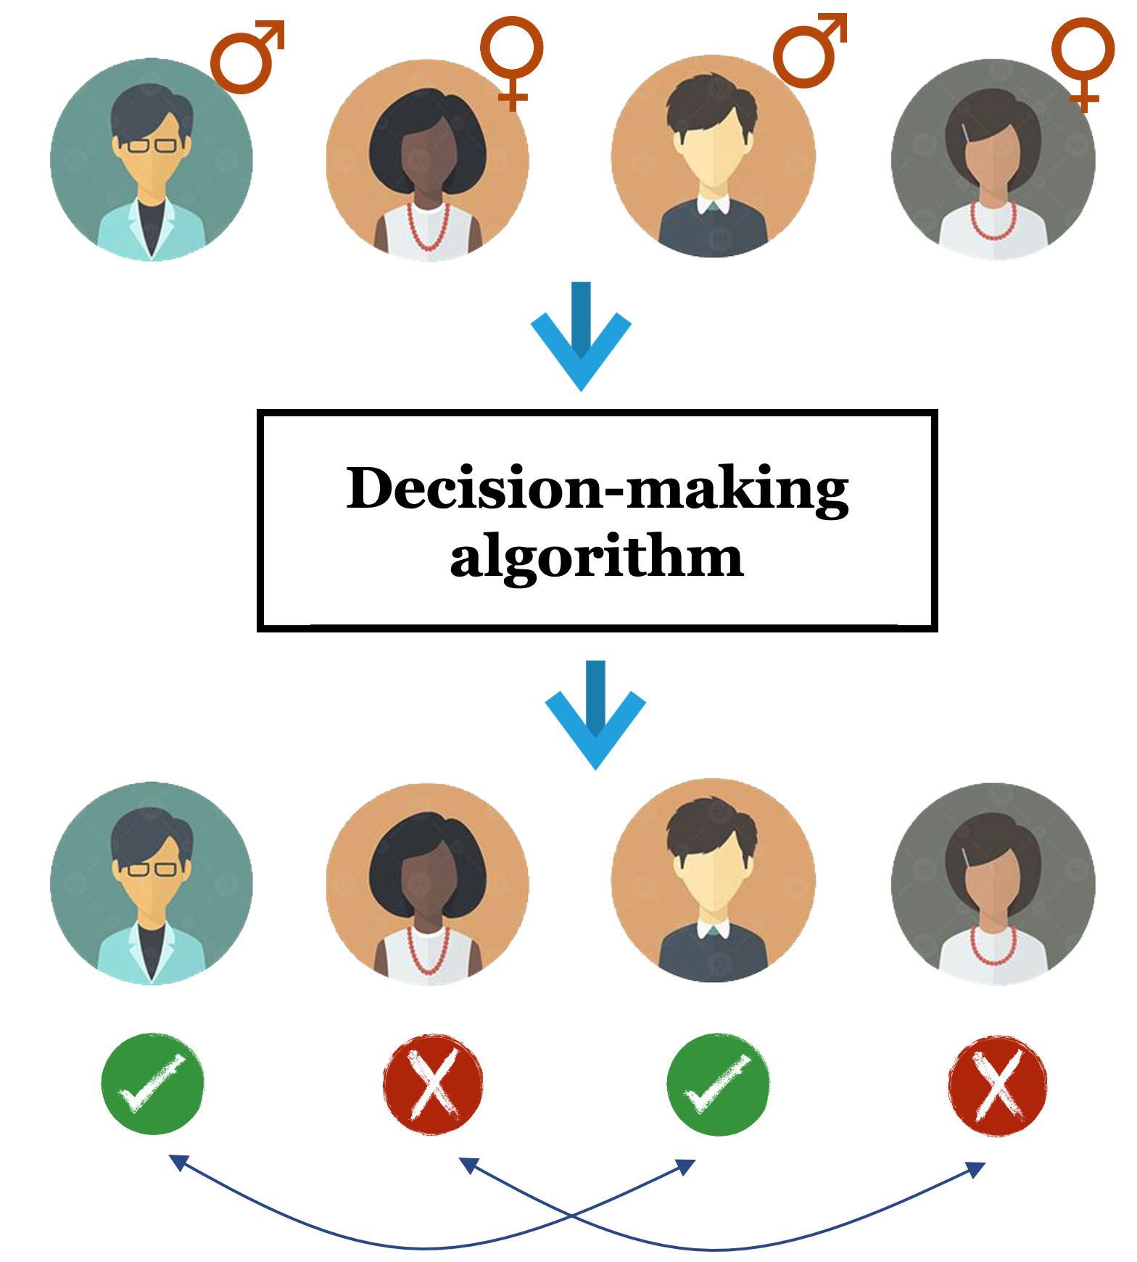

Different Fairness Notions: Group v.s. Individual
Group Fairness
Decision-making algorithm should not make biased prediction towards people with certain sensitive feature.
Male
Prediction
Female
Sensitive feature: gender
Females get discriminated.
06/20/2021
7
Individual Fairness for Graph Neural Networks: A Ranking based Approach
03/08/2021
Individual Fairness for Graph Neural Networks: A Ranking based Approach
Notes:
This is an outline of my today’s talk.
Firstly, I will give you a brief overview about the research I have presented in my proposal defense.
Next, I will talk about additional two pieces of work that I have done about some applications on attributed networks.
At last, I will give a summary about my dissertation research and vision about the future work.

Slide 8
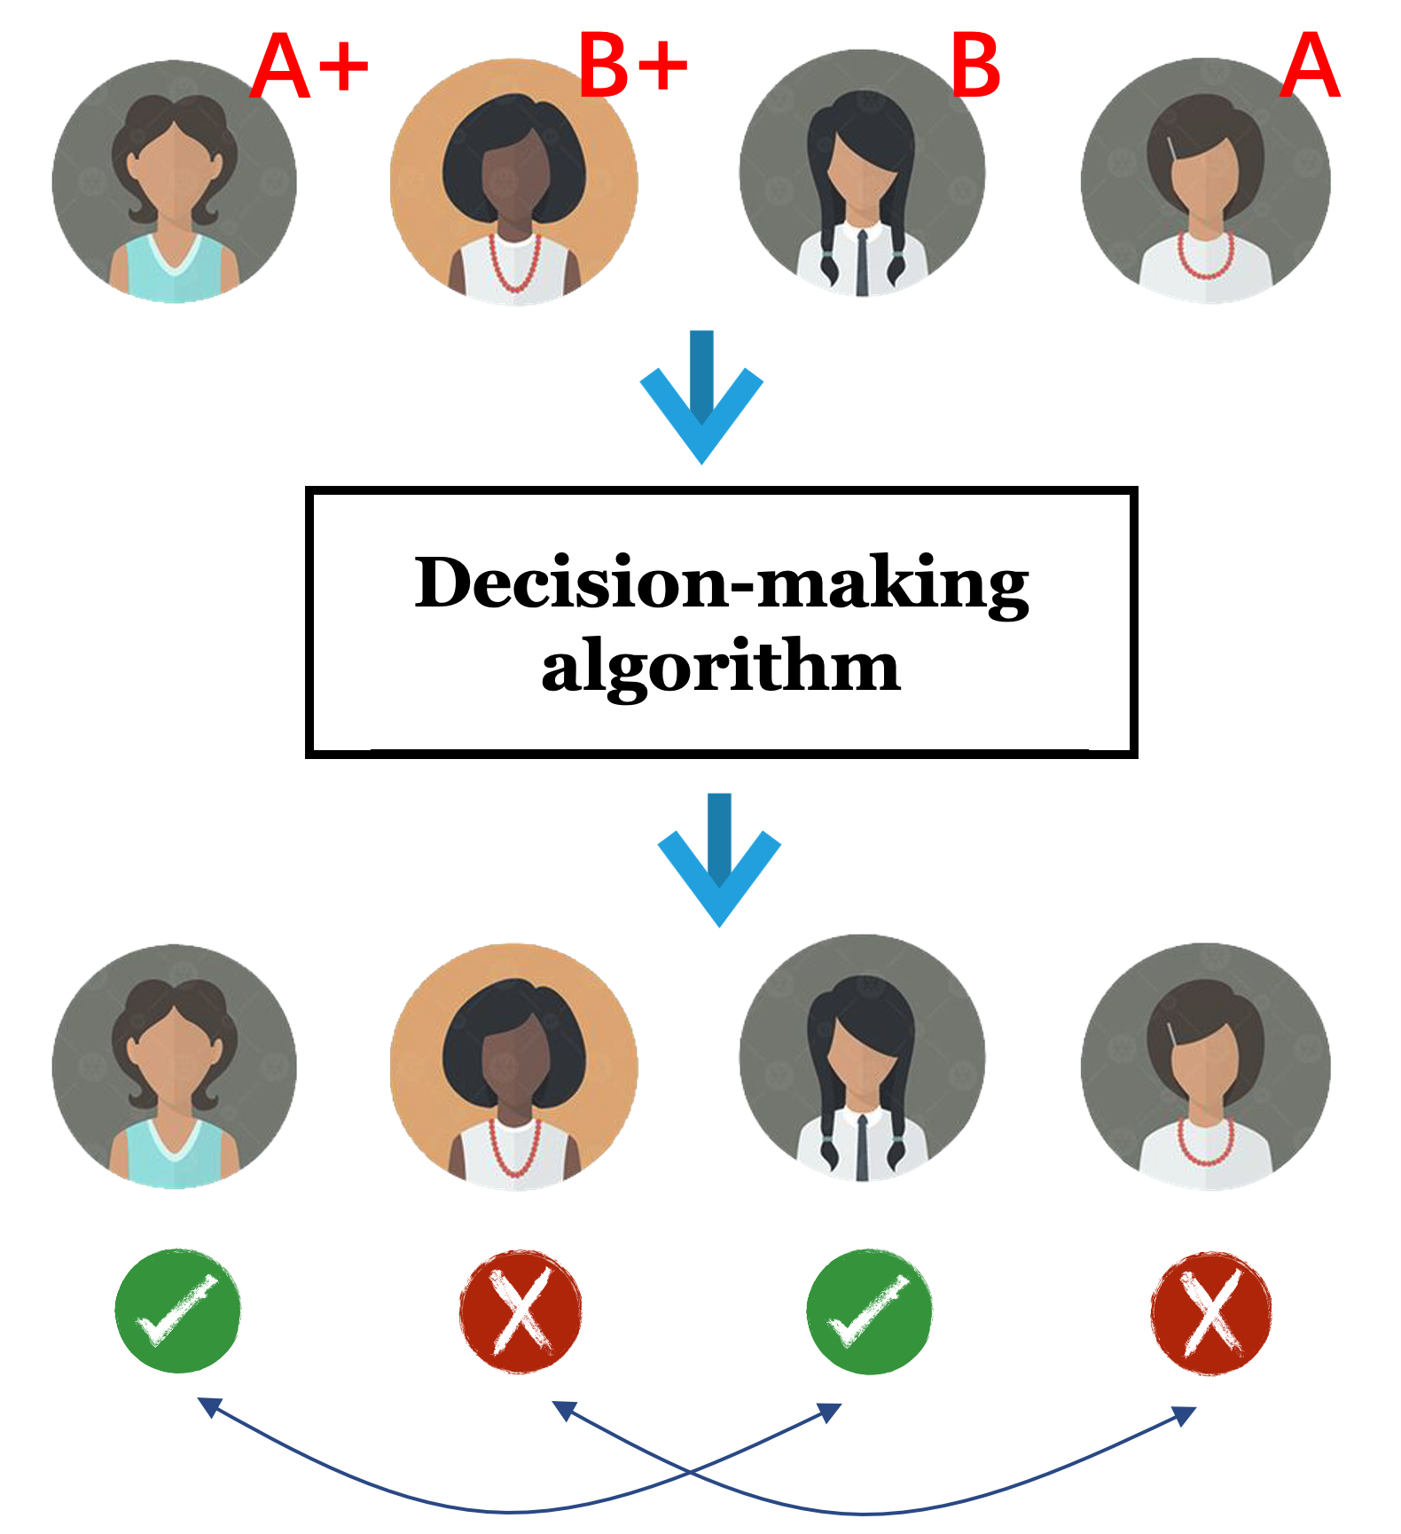
Different Fairness Notions: Group v.s. Individual
Individual Fairness: higher granularity
Similar people should be treated similarly.
A+
A
Prediction
Similar
B+
B
Similar
Similar pairs do not receive similar output.
06/20/2021
8
Individual Fairness for Graph Neural Networks: A Ranking based Approach
03/08/2021
Individual Fairness for Graph Neural Networks: A Ranking based Approach
Notes:
This is an outline of my today’s talk.
Firstly, I will give you a brief overview about the research I have presented in my proposal defense.
Next, I will talk about additional two pieces of work that I have done about some applications on attributed networks.
At last, I will give a summary about my dissertation research and vision about the future work.

Slide 9
Goal of this work
Up to now, group fairness has been thoroughly explored in GNNs.
As a more granular fairness notion, individual fairness has not been studied in GNNs.
?
Goal: Promoting individual fairness in GNNs.
06/20/2021
9
Individual Fairness for Graph Neural Networks: A Ranking based Approach
03/08/2021
Individual Fairness for Graph Neural Networks: A Ranking based Approach
Notes:
This is an outline of my today’s talk.
Firstly, I will give you a brief overview about the research I have presented in my proposal defense.
Next, I will talk about additional two pieces of work that I have done about some applications on attributed networks.
At last, I will give a summary about my dissertation research and vision about the future work.

Slide 10
Outline
Background Introduction
Previous Works
Existing Problems & Challenges
Our Solutions
Experiments & Conclusion
Future Works
06/20/2021
10
Individual Fairness for Graph Neural Networks: A Ranking based Approach
03/08/2021
Individual Fairness for Graph Neural Networks: A Ranking based Approach
Notes:
This is an outline of my today’s talk.
Firstly, I will give you a brief overview about the research I have presented in my proposal defense.
Next, I will talk about additional two pieces of work that I have done about some applications on attributed networks.
At last, I will give a summary about my dissertation research and vision about the future work.

Slide 11
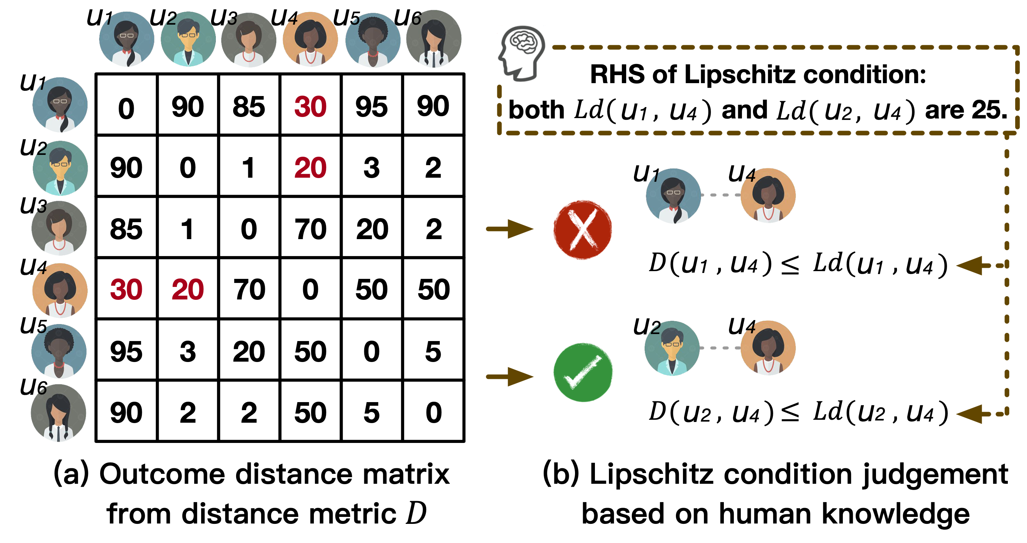
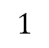
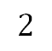
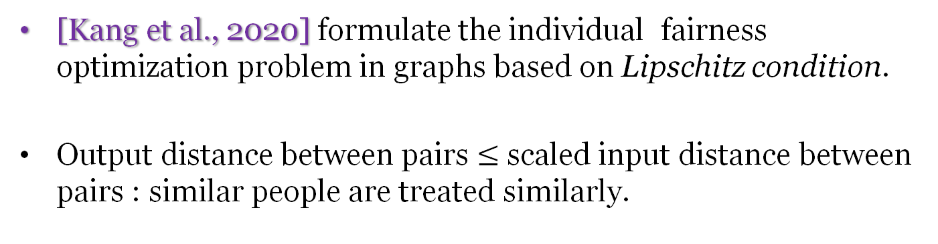
Previous works
[Kang et al., 2020] formulate the individual fairness optimization problem in graphs based on Lipschitz condition.
Output distance between pairs $≤$ scaled input distance between pairs : similar people are treated similarly.
Lipschitz condition:
$$1$$
$$2$$
Lipschitz constant
Output distance
Input distance
[Kang et al., 2020] Kang J, He J, Maciejewski R, et al. InFoRM: Individual Fairness on Graph Mining[C]//Proceedings of the 26th ACM SIGKDD International Conference on Knowledge Discovery & Data Mining. 2020: 379-389.
06/20/2021
11
Individual Fairness for Graph Neural Networks: A Ranking based Approach
03/08/2021
Individual Fairness for Graph Neural Networks: A Ranking based Approach
Notes:
This is an outline of my today’s talk.
Firstly, I will give you a brief overview about the research I have presented in my proposal defense.
Next, I will talk about additional two pieces of work that I have done about some applications on attributed networks.
At last, I will give a summary about my dissertation research and vision about the future work.

Slide 12
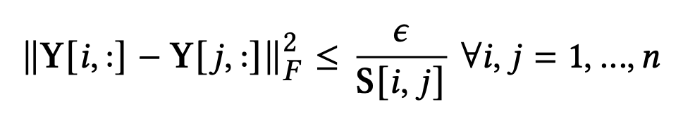
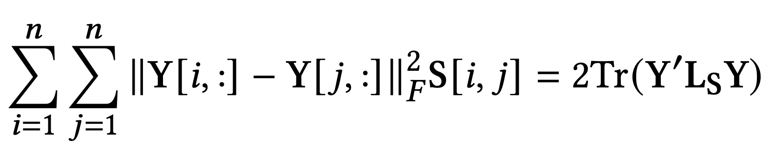
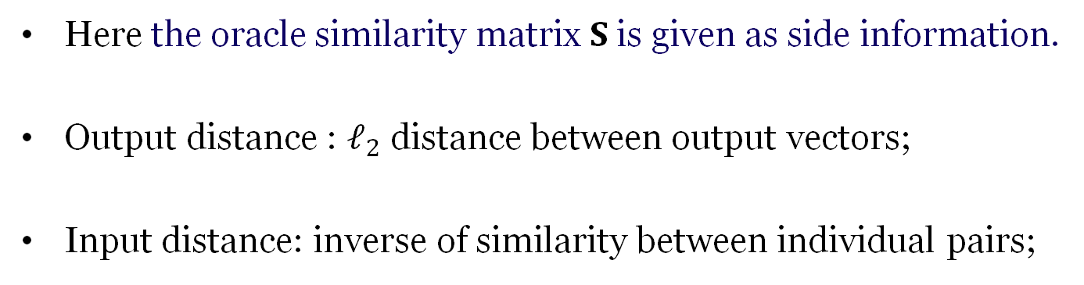
Previous works
Here the oracle similarity matrix $S$ is given as side information.
Output distance : $ℓ_{2}$ distance between output vectors;
Input distance: inverse of similarity between individual pairs;
Lipschitz condition:
$$1$$
$$2$$
Lipschitz constant
Output distance
Input distance
06/20/2021
12
Individual Fairness for Graph Neural Networks: A Ranking based Approach
03/08/2021
Individual Fairness for Graph Neural Networks: A Ranking based Approach
Notes:
This is an outline of my today’s talk.
Firstly, I will give you a brief overview about the research I have presented in my proposal defense.
Next, I will talk about additional two pieces of work that I have done about some applications on attributed networks.
At last, I will give a summary about my dissertation research and vision about the future work.

Slide 13
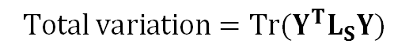
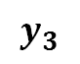
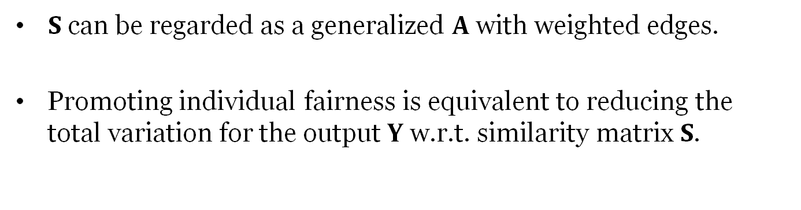
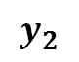
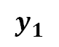
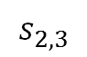
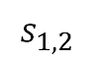
Previous works
$S$ can be regarded as a generalized $A$ with weighted edges.
Promoting individual fairness is equivalent to reducing the total variation for the output $Y$ w.r.t. similarity matrix $S$.
$$y_{1}$$
$$y_{3}$$
$$s_{1,2}$$
$$s_{2,3}$$
$$y_{2}$$
$$Total variation=Tr(Y^{T}L_{S}Y)$$
A more intuitive understanding.
06/20/2021
13
Individual Fairness for Graph Neural Networks: A Ranking based Approach
03/08/2021
Individual Fairness for Graph Neural Networks: A Ranking based Approach
Notes:
This is an outline of my today’s talk.
Firstly, I will give you a brief overview about the research I have presented in my proposal defense.
Next, I will talk about additional two pieces of work that I have done about some applications on attributed networks.
At last, I will give a summary about my dissertation research and vision about the future work.

Slide 14
Outline
Background Introduction
Previous Works
Existing Problems & Challenges
Our Solutions
Experiments & Conclusion
Future Works
06/20/2021
14
Individual Fairness for Graph Neural Networks: A Ranking based Approach
03/08/2021
Individual Fairness for Graph Neural Networks: A Ranking based Approach
Notes:
This is an outline of my today’s talk.
Firstly, I will give you a brief overview about the research I have presented in my proposal defense.
Next, I will talk about additional two pieces of work that I have done about some applications on attributed networks.
At last, I will give a summary about my dissertation research and vision about the future work.

Slide 15
Existing Problems & Challenges
Constraint Formulation.
Lipschitz constant
Output distance
Input distance
From different domains and different distance metrics.
How can we achieve individual fairness without specifying such a constant and avoid distance comparison across domains?
06/20/2021
15
Individual Fairness for Graph Neural Networks: A Ranking based Approach
03/08/2021
Individual Fairness for Graph Neural Networks: A Ranking based Approach
Notes:
This is an outline of my today’s talk.
Firstly, I will give you a brief overview about the research I have presented in my proposal defense.
Next, I will talk about additional two pieces of work that I have done about some applications on attributed networks.
At last, I will give a summary about my dissertation research and vision about the future work.

Slide 16
Existing Problems & Challenges
Distance Calibration.
How can we achieve individual fairness with natural calibration across different individuals?
06/20/2021
16
Individual Fairness for Graph Neural Networks: A Ranking based Approach
03/08/2021
Individual Fairness for Graph Neural Networks: A Ranking based Approach
Notes:
This is an outline of my today’s talk.
Firstly, I will give you a brief overview about the research I have presented in my proposal defense.
Next, I will talk about additional two pieces of work that I have done about some applications on attributed networks.
At last, I will give a summary about my dissertation research and vision about the future work.

Slide 17
Existing Problems & Challenges
End-to-End Learning Paradigm.
Back propagation for parameter learning
Ground truth
Prediction
An important advantage of GNN is its end-to-end learning* paradigm. How can we achieve individual fairness without jeopardizing such advantage?
*End-to-end learning usually refers to omitting any hand-crafted intermediary algorithms and directly learning the solution of a given problem from the sampled dataset.
06/20/2021
17
Individual Fairness for Graph Neural Networks: A Ranking based Approach
03/08/2021
Individual Fairness for Graph Neural Networks: A Ranking based Approach
Notes:
This is an outline of my today’s talk.
Firstly, I will give you a brief overview about the research I have presented in my proposal defense.
Next, I will talk about additional two pieces of work that I have done about some applications on attributed networks.
At last, I will give a summary about my dissertation research and vision about the future work.

Slide 18
Outline
Background Introduction
Previous Works
Existing Problems & Challenges
Our Solutions
Experiments & Conclusion
Future Works
06/20/2021
18
Individual Fairness for Graph Neural Networks: A Ranking based Approach
03/08/2021
Individual Fairness for Graph Neural Networks: A Ranking based Approach
Notes:
This is an outline of my today’s talk.
Firstly, I will give you a brief overview about the research I have presented in my proposal defense.
Next, I will talk about additional two pieces of work that I have done about some applications on attributed networks.
At last, I will give a summary about my dissertation research and vision about the future work.

Slide 19
Our Solutions: Outline
Constraint Formulation.
Distance Calibration.
End-to-End Learning Paradigm
New individual fairness definition from a ranking perspective.
Problem formulation.
REDRESS framework.
06/20/2021
19
Individual Fairness for Graph Neural Networks: A Ranking based Approach
03/08/2021
Individual Fairness for Graph Neural Networks: A Ranking based Approach
Notes:
This is an outline of my today’s talk.
Firstly, I will give you a brief overview about the research I have presented in my proposal defense.
Next, I will talk about additional two pieces of work that I have done about some applications on attributed networks.
At last, I will give a summary about my dissertation research and vision about the future work.

Slide 20


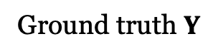
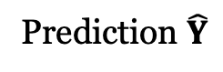
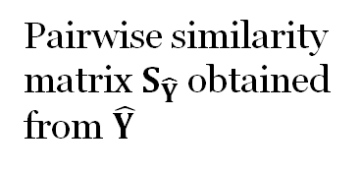
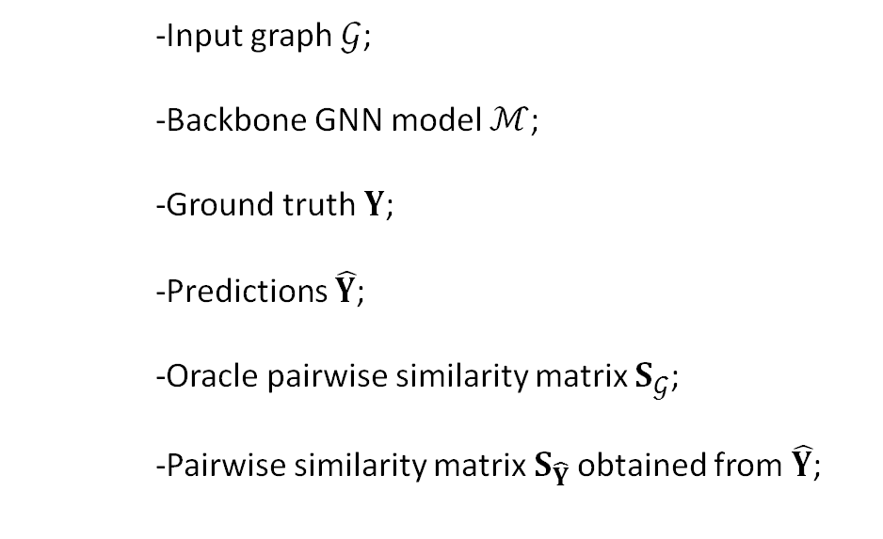
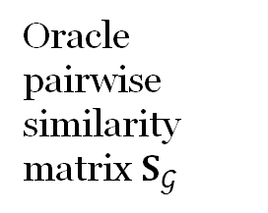
Our Solutions: Ranking-based Individual Fairness
Input graph $𝒢$;
Backbone GNN model $ℳ$;
Ground truth $Y$;
Predictions $\hat{Y}$;
Oracle pairwise similarity matrix $S_{𝒢}$;
Pairwise similarity matrix$S_{\hat{Y}}$ obtained from $\hat{Y}$;
Traditional GNN based graph mining data flow without fairness consideration:
Prediction $\hat{Y}$
Ground truth $Y$
Extra fairness indicators for input and output data:
Oracle pairwise similarity matrix $S_{𝒢}$
Pairwise similarity matrix$S_{\hat{Y}}$ obtained from $\hat{Y}$
06/20/2021
20
Individual Fairness for Graph Neural Networks: A Ranking based Approach
03/08/2021
Individual Fairness for Graph Neural Networks: A Ranking based Approach
Notes:
This is an outline of my today’s talk.
Firstly, I will give you a brief overview about the research I have presented in my proposal defense.
Next, I will talk about additional two pieces of work that I have done about some applications on attributed networks.
At last, I will give a summary about my dissertation research and vision about the future work.

Slide 21
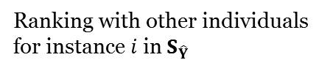
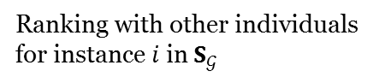
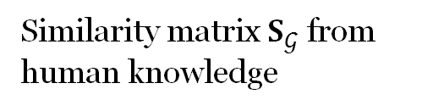
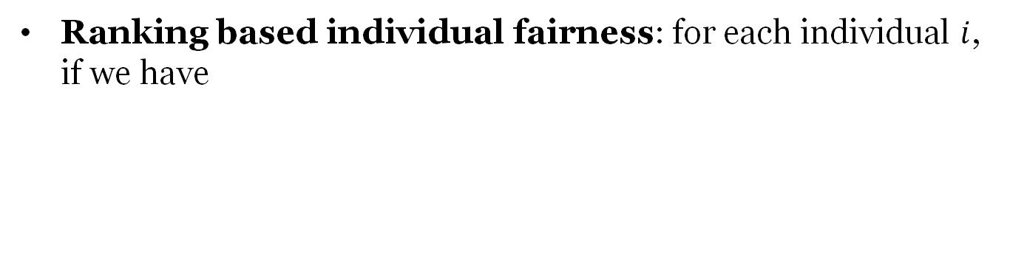
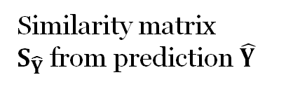
Our Solutions: Ranking-based Individual Fairness
Ranking based individual fairness: for each individual $i$, if we have
Similarity matrix $S_{𝒢}$ from human knowledge
Similarity matrix $S_{\hat{Y}}$from prediction $\hat{Y}$
Consistent
Ranking with other individuals for instance $i$ in $S_{𝒢}$
Ranking with other individuals for instance $i$ in $S_{\hat{Y}}$
06/20/2021
21
Individual Fairness for Graph Neural Networks: A Ranking based Approach
03/08/2021
Individual Fairness for Graph Neural Networks: A Ranking based Approach
Notes:
This is an outline of my today’s talk.
Firstly, I will give you a brief overview about the research I have presented in my proposal defense.
Next, I will talk about additional two pieces of work that I have done about some applications on attributed networks.
At last, I will give a summary about my dissertation research and vision about the future work.

Slide 22
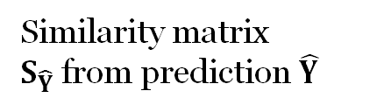
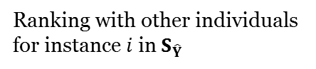
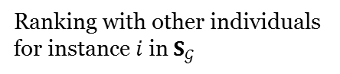
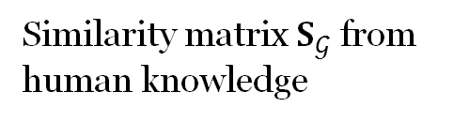
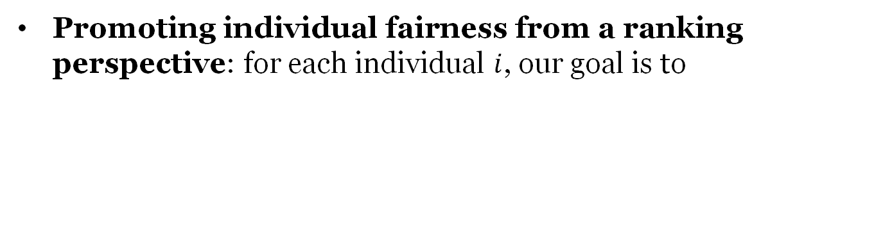
Our Solutions: Ranking-based Problem Formulation
Promoting individual fairness from a ranking perspective: for each individual $i$, our goal is to
Similarity matrix $S_{𝒢}$ from human knowledge
Similarity matrix $S_{\hat{Y}}$from prediction $\hat{Y}$
As similar as possible
Ranking with other individuals for instance $i$ in $S_{𝒢}$
Ranking with other individuals for instance $i$ in $S_{\hat{Y}}$
06/20/2021
22
Individual Fairness for Graph Neural Networks: A Ranking based Approach
03/08/2021
Individual Fairness for Graph Neural Networks: A Ranking based Approach
Notes:
This is an outline of my today’s talk.
Firstly, I will give you a brief overview about the research I have presented in my proposal defense.
Next, I will talk about additional two pieces of work that I have done about some applications on attributed networks.
At last, I will give a summary about my dissertation research and vision about the future work.

Slide 23
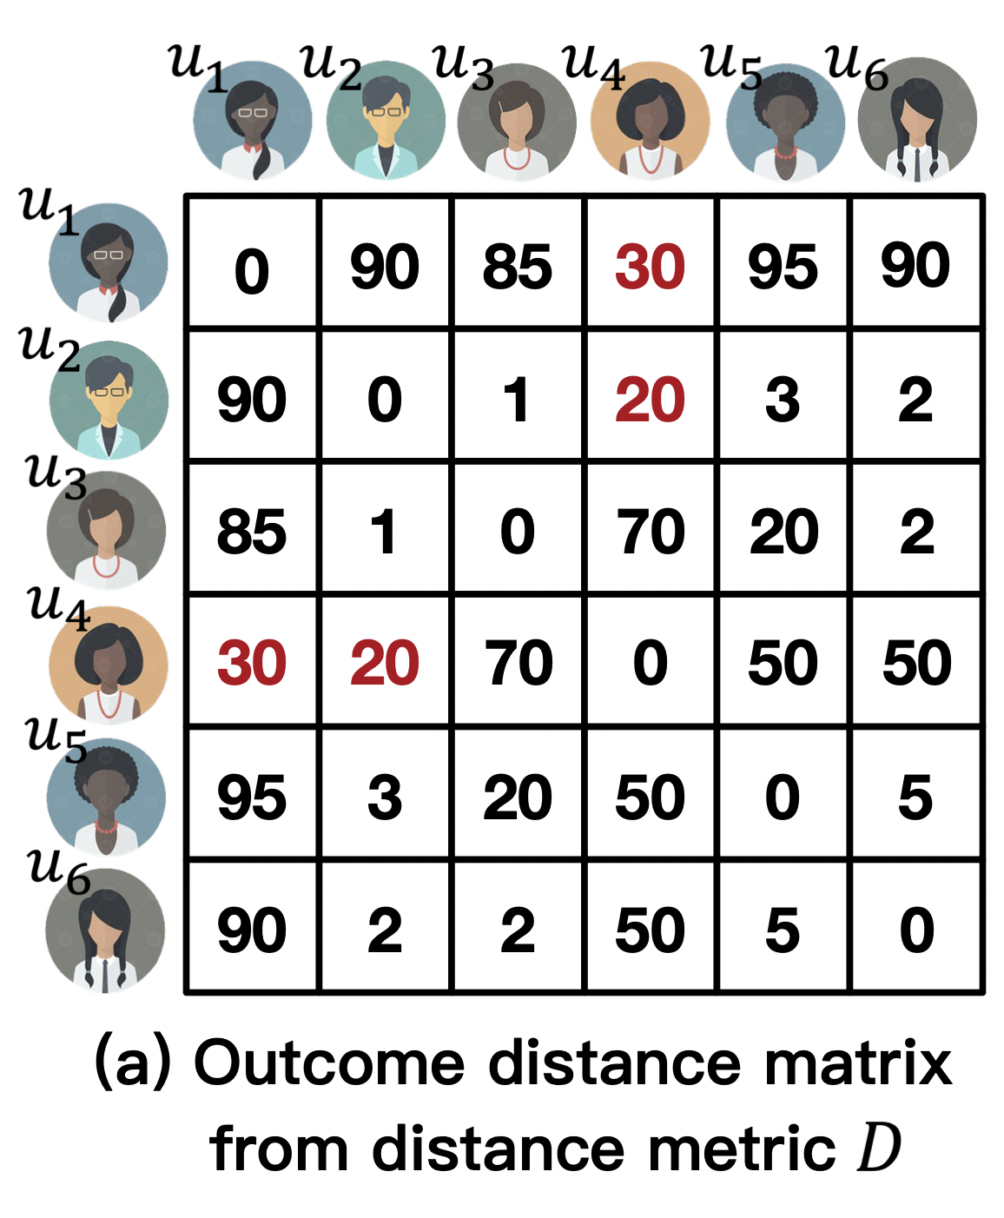

Our Solutions: Ranking-based Problem Formulation
The newly proposed Ranking-based individual fairness definition & corresponding problem formulation:
Naturally calibrate across individuals;
Provide a new constraint criterion to achieve individual fairness;
Ranking from :
Ranking from :
06/20/2021
23
Individual Fairness for Graph Neural Networks: A Ranking based Approach
03/08/2021
Individual Fairness for Graph Neural Networks: A Ranking based Approach
Notes:
This is an outline of my today’s talk.
Firstly, I will give you a brief overview about the research I have presented in my proposal defense.
Next, I will talk about additional two pieces of work that I have done about some applications on attributed networks.
At last, I will give a summary about my dissertation research and vision about the future work.

Slide 24
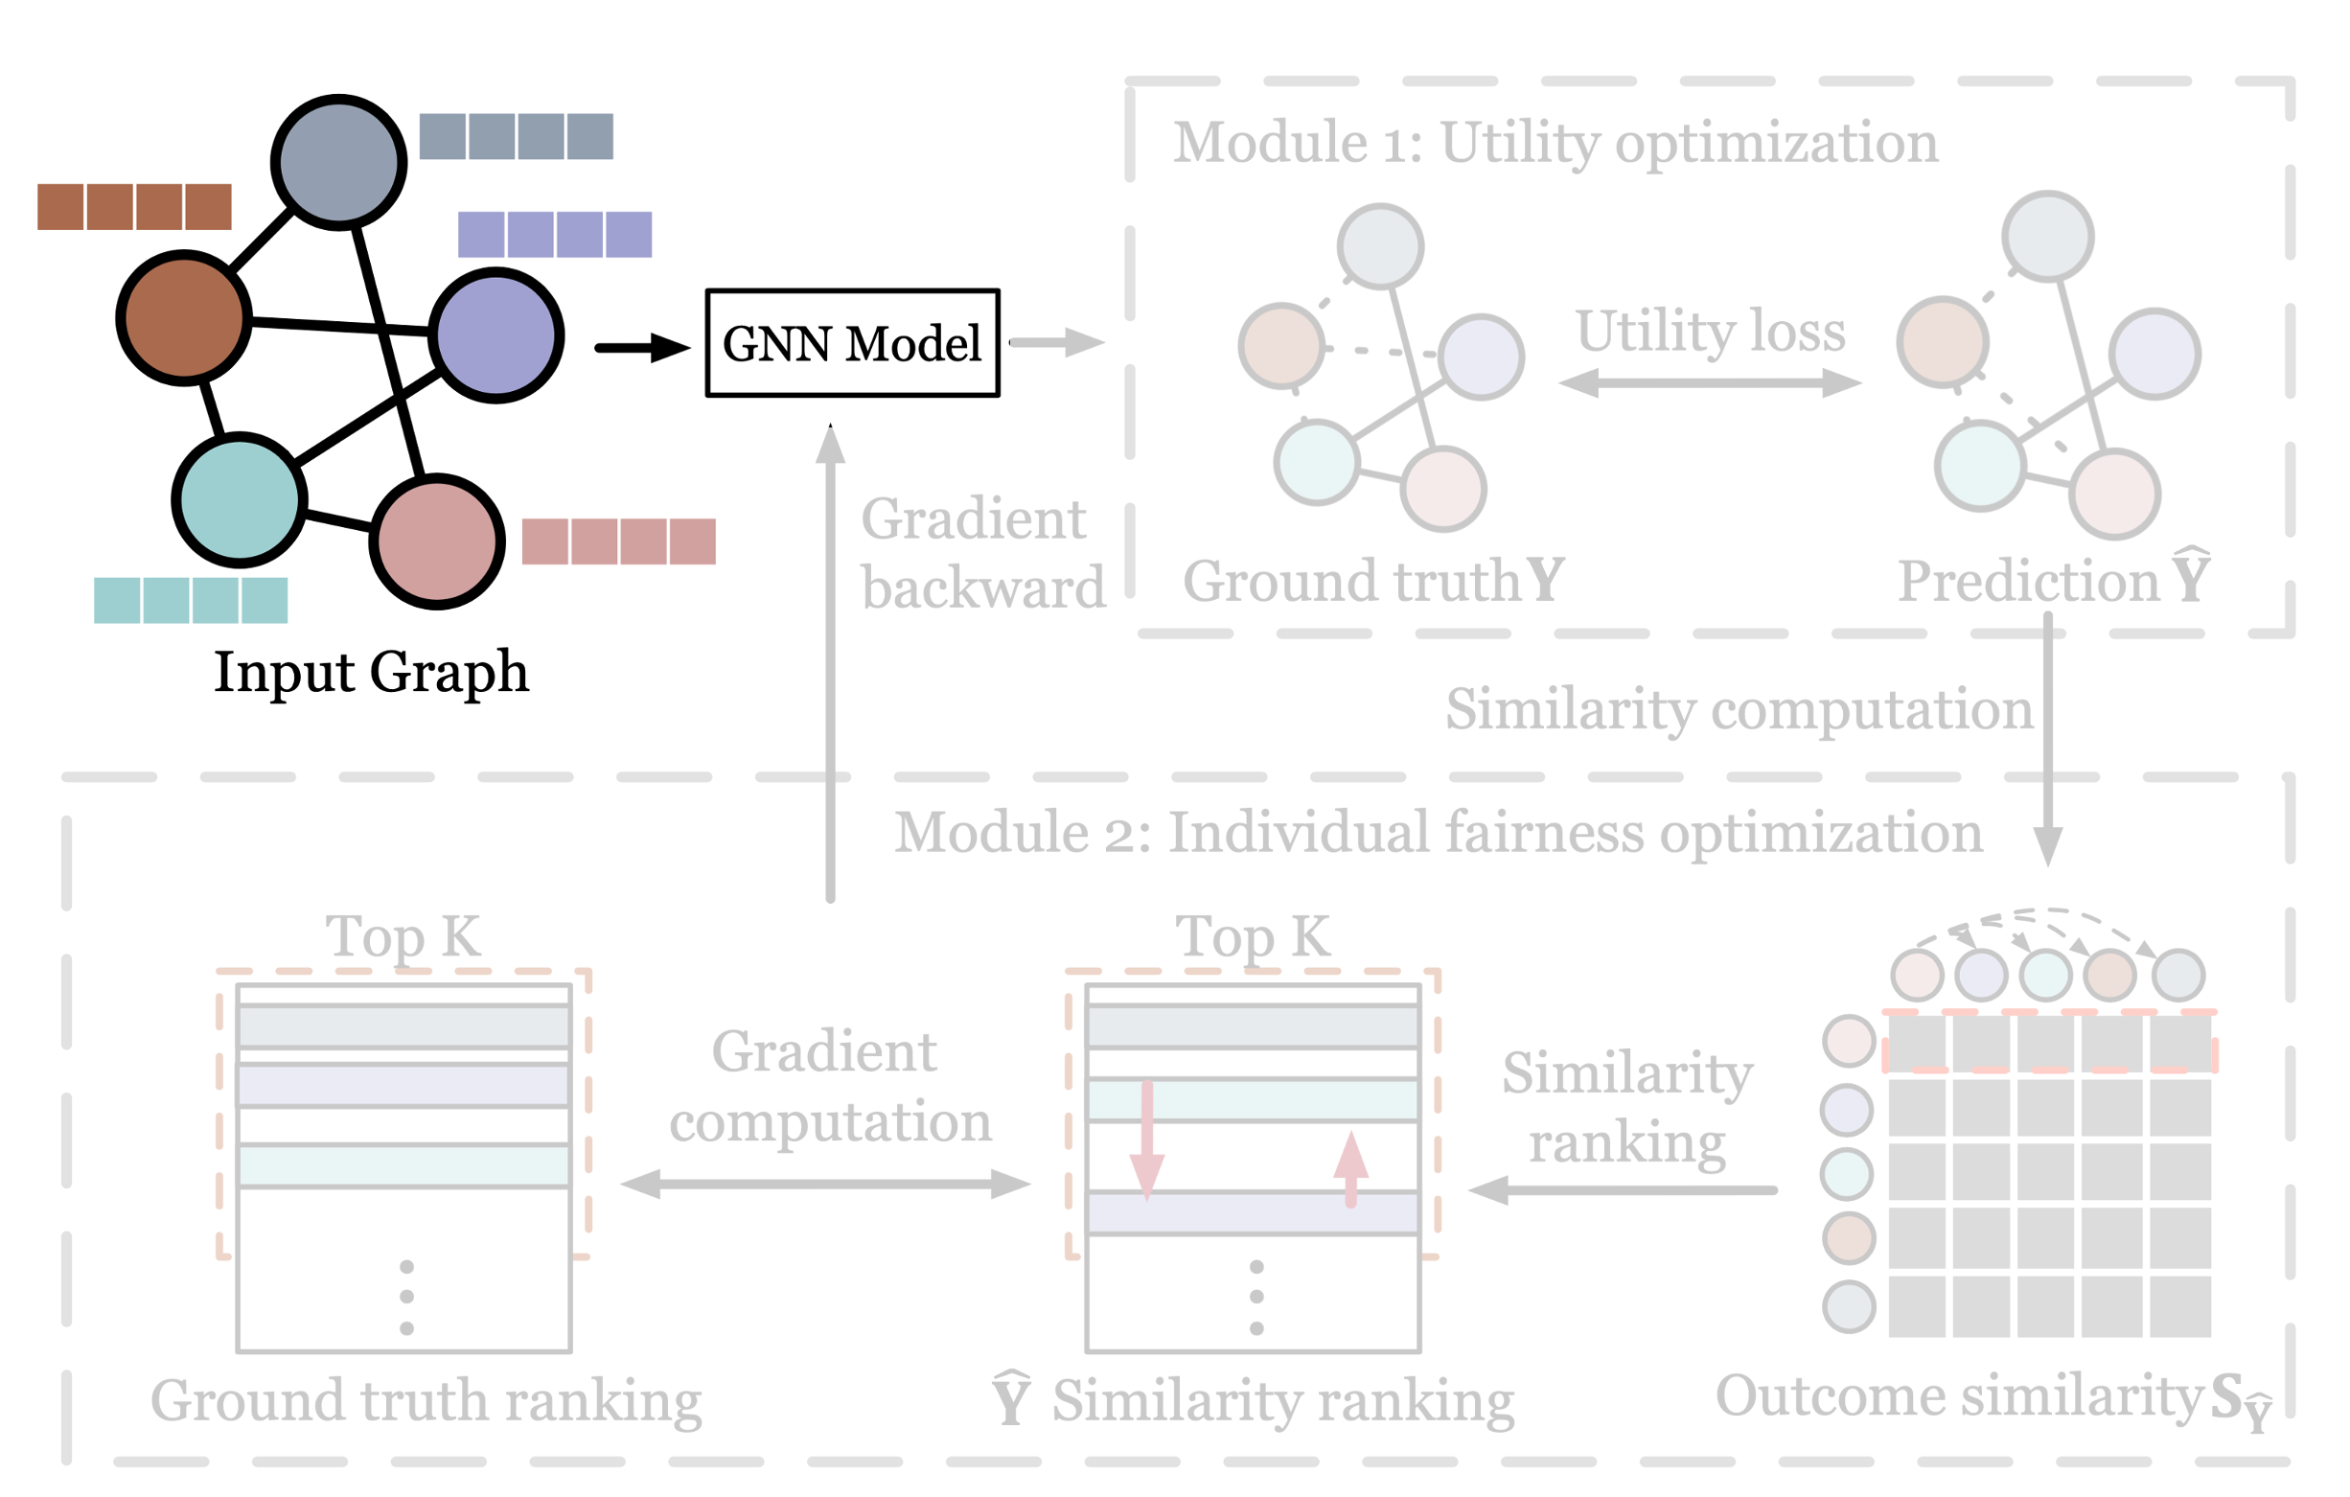

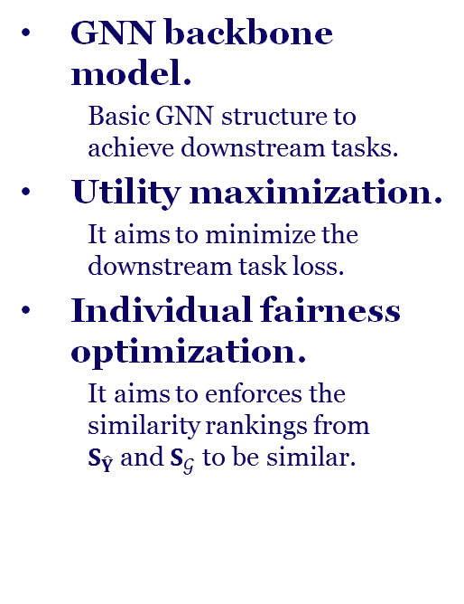
Our Solutions: Proposed Framework—REDRESS
GNN backbone model.
Basic GNN structure to achieve downstream tasks.
Utility maximization.
It aims to minimize the downstream task loss.
Individual fairness optimization.
It aims to enforces the similarity rankings from $S_{\hat{Y}}$and $S_{𝒢}$ to be similar.
06/20/2021
24
Individual Fairness for Graph Neural Networks: A Ranking based Approach
03/08/2021
Individual Fairness for Graph Neural Networks: A Ranking based Approach
Notes:
This is an outline of my today’s talk.
Firstly, I will give you a brief overview about the research I have presented in my proposal defense.
Next, I will talk about additional two pieces of work that I have done about some applications on attributed networks.
At last, I will give a summary about my dissertation research and vision about the future work.

Slide 25
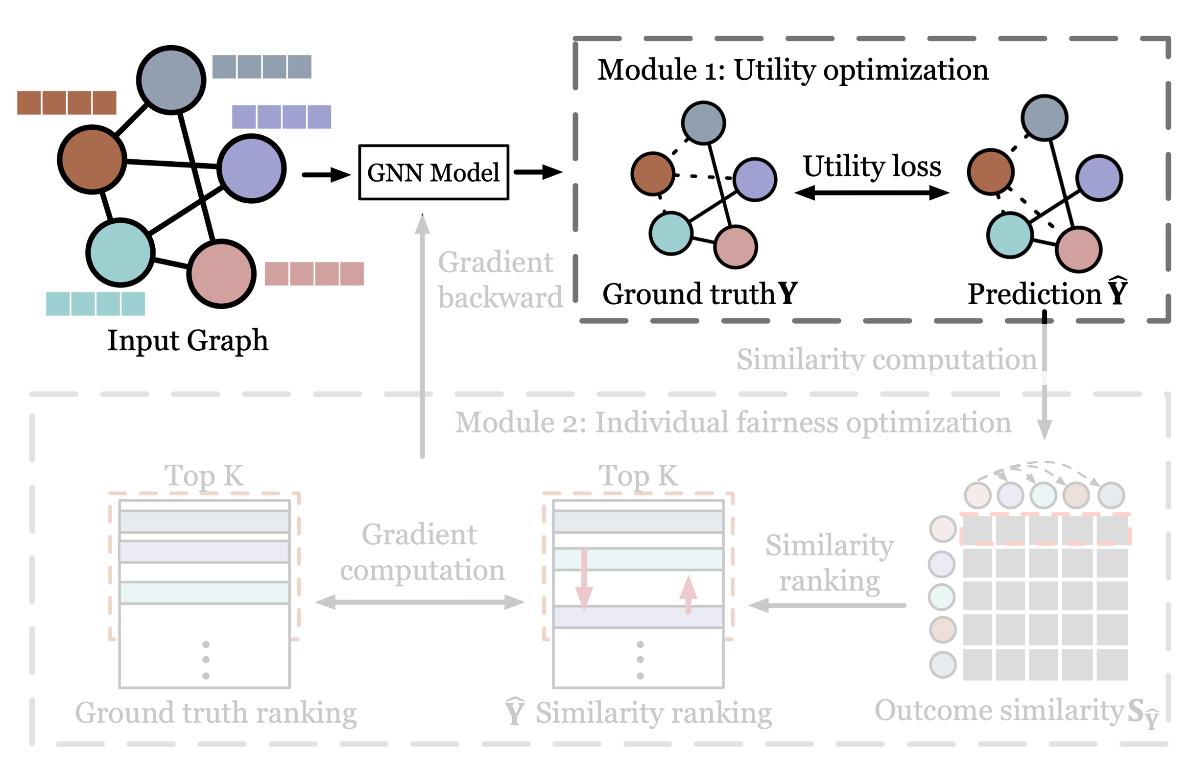
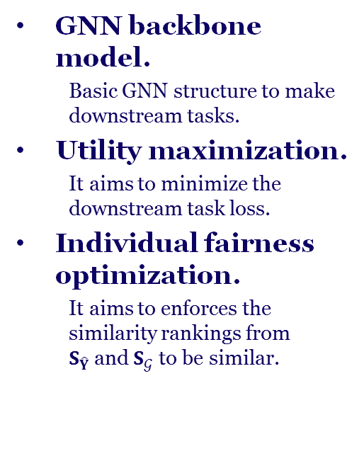
Our Solutions: Proposed Framework—REDRESS
GNN backbone model.
Basic GNN structure to make downstream tasks.
Utility maximization.
It aims to minimize the downstream task loss.
Individual fairness optimization.
It aims to enforces the similarity rankings from $S_{\hat{Y}}$and $S_{𝒢}$ to be similar.
06/20/2021
25
Individual Fairness for Graph Neural Networks: A Ranking based Approach
03/08/2021
Individual Fairness for Graph Neural Networks: A Ranking based Approach
Notes:
This is an outline of my today’s talk.
Firstly, I will give you a brief overview about the research I have presented in my proposal defense.
Next, I will talk about additional two pieces of work that I have done about some applications on attributed networks.
At last, I will give a summary about my dissertation research and vision about the future work.

Slide 26
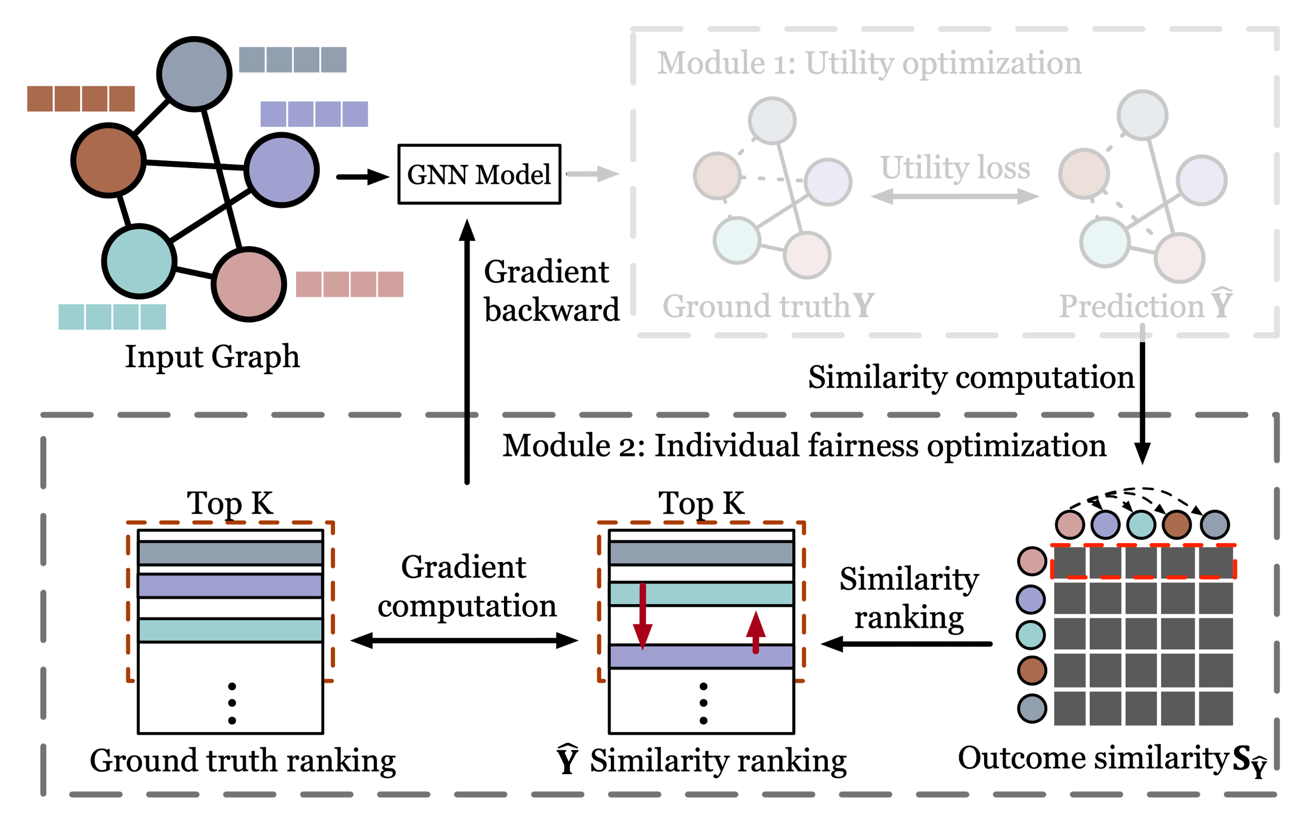
Our Solutions: Proposed Framework—REDRESS
GNN backbone model.
Basic GNN structure to make downstream tasks.
Utility maximization.
It aims to minimize the downstream task loss.
Individual fairness optimization.
It aims to enforces the similarity rankings from $S_{\hat{Y}}$and $S_{𝒢}$ to be similar.
06/20/2021
26
Individual Fairness for Graph Neural Networks: A Ranking based Approach
03/08/2021
Individual Fairness for Graph Neural Networks: A Ranking based Approach
Notes:
This is an outline of my today’s talk.
Firstly, I will give you a brief overview about the research I have presented in my proposal defense.
Next, I will talk about additional two pieces of work that I have done about some applications on attributed networks.
At last, I will give a summary about my dissertation research and vision about the future work.

Slide 27
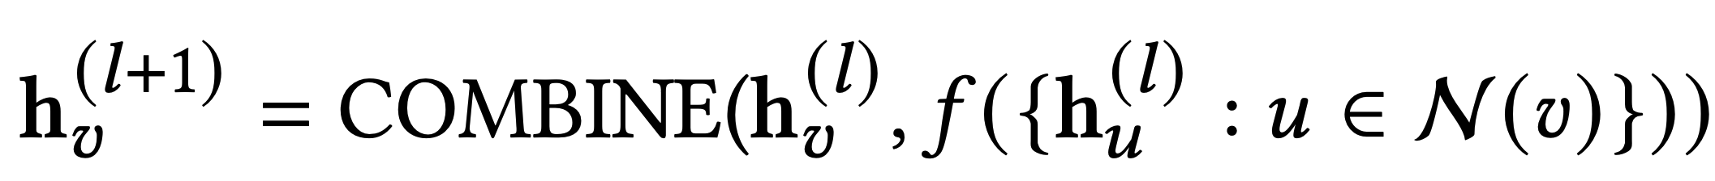
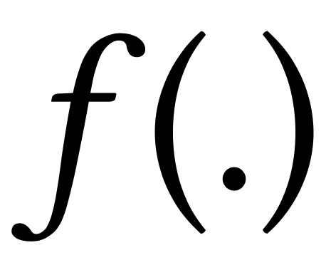





REDRESS–GNN Backbone
GNN backbone: The basic operation of GNN between $l$–th layer and $(l+1)$–th layer can be summarized as:
:
Embedding of node $υ$ at $(l+1)$-th layer;
:
Information aggregation function;
:
Information combine function;
:
Activation function;
:
Neighborhood set of node $υ$;
06/20/2021
27
Individual Fairness for Graph Neural Networks: A Ranking based Approach
03/08/2021
Individual Fairness for Graph Neural Networks: A Ranking based Approach
Notes:
This is an outline of my today’s talk.
Firstly, I will give you a brief overview about the research I have presented in my proposal defense.
Next, I will talk about additional two pieces of work that I have done about some applications on attributed networks.
At last, I will give a summary about my dissertation research and vision about the future work.

Slide 28

REDRESS–Utility Maximization
Utility maximization: loss function can be initialized as the cross-entropy between predictions and ground truth.
Node classification: $𝒯$ is the (node, class) tuple set for training nodes.
Link prediction : $𝒯$ is the (node, node) tuple set for the vertices of training edges.
06/20/2021
28
Individual Fairness for Graph Neural Networks: A Ranking based Approach
03/08/2021
Individual Fairness for Graph Neural Networks: A Ranking based Approach
Notes:
This is an outline of my today’s talk.
Firstly, I will give you a brief overview about the research I have presented in my proposal defense.
Next, I will talk about additional two pieces of work that I have done about some applications on attributed networks.
At last, I will give a summary about my dissertation research and vision about the future work.

Slide 29






REDRESS–Individual Fairness Optimization
Individual fairness optimization: for every node, the two similarity ranking lists with other nodes derived from $S_{\hat{Y}}$ and $S_{𝒢}$ should be similar.
Example: Ranking* from
Ranking in $S_{\hat{Y}}$ derived
from prediction $\hat{Y}$
Ground truth ranking from
human knowledge $S_{𝒢}$
$$u_{3}{ u}_{4}{ u}_{2 }u_{5}$$
$$u_{4}{ u}_{3}{ u}_{2 }u_{5}$$
Goal: to make the two ranking lists as similar as possible.
*We omit $u_{6}$ for simplification purpose.
06/20/2021
29
Individual Fairness for Graph Neural Networks: A Ranking based Approach
03/08/2021
Individual Fairness for Graph Neural Networks: A Ranking based Approach
Notes:
This is an outline of my today’s talk.
Firstly, I will give you a brief overview about the research I have presented in my proposal defense.
Next, I will talk about additional two pieces of work that I have done about some applications on attributed networks.
At last, I will give a summary about my dissertation research and vision about the future work.

Slide 30
REDRESS–Individual Fairness Optimization
Individual fairness optimization: for every node, the two similarity ranking lists with other nodes derived from $S_{\hat{Y}}$ and $S_{𝒢}$ should be similar.
Example: Ranking* from
Ranking in $S_{\hat{Y}}$ derived
from prediction $\hat{Y}$
Ground truth ranking from
human knowledge $S_{𝒢}$
$$u_{3}{ u}_{4}{ u}_{2 }u_{5}$$
$$u_{4}{ u}_{3}{ u}_{2 }u_{5}$$
Directly defining a loss between the two ranking lists: loss is non-differentiable.
*We omit $u_{6}$ for simplification purpose.
06/20/2021
30
Individual Fairness for Graph Neural Networks: A Ranking based Approach
03/08/2021
Individual Fairness for Graph Neural Networks: A Ranking based Approach
Notes:
This is an outline of my today’s talk.
Firstly, I will give you a brief overview about the research I have presented in my proposal defense.
Next, I will talk about additional two pieces of work that I have done about some applications on attributed networks.
At last, I will give a summary about my dissertation research and vision about the future work.

Slide 31








REDRESS–Individual Fairness Optimization
We turn to make the relative ranking order of every pair to be consistent with that in the ground truth ranking.
Take as an example:
$$u_{3}$$
Ranking in $S_{\hat{Y}}$ derived
from prediction $\hat{Y}$
Ground truth ranking from
human knowledge $S_{𝒢}$
$$u_{3}{ u}_{4}$$
$$u_{4}{ u}_{3}$$
$$u_{3}{ u}_{2}$$
$$u_{3}{ u}_{2}$$
$$u_{3}{ u}_{5}$$
$$u_{3}{ u}_{5}$$
06/20/2021
31
Individual Fairness for Graph Neural Networks: A Ranking based Approach
03/08/2021
Individual Fairness for Graph Neural Networks: A Ranking based Approach
Notes:
This is an outline of my today’s talk.
Firstly, I will give you a brief overview about the research I have presented in my proposal defense.
Next, I will talk about additional two pieces of work that I have done about some applications on attributed networks.
At last, I will give a summary about my dissertation research and vision about the future work.

Slide 32





REDRESS–Individual Fairness Optimization
Ranking in $S_{\hat{Y}}$ derived
from prediction $\hat{Y}$
Ground truth ranking from
human knowledge $S_{𝒢}$
$$u_{3}{ u}_{4}$$
$$u_{4}{ u}_{3}$$
Probability of ‘$u$ is ahead of $υ$’ is modeled as a logistic sigmoid function:
We set the corresponding ground truth as
+1
the 𝑢-th one ranks higher
0
the 𝑢-th and 𝑣-th one rank samely
-1
the 𝑣-th one ranks higher
06/20/2021
32
Individual Fairness for Graph Neural Networks: A Ranking based Approach
03/08/2021
Individual Fairness for Graph Neural Networks: A Ranking based Approach
Notes:
This is an outline of my today’s talk.
Firstly, I will give you a brief overview about the research I have presented in my proposal defense.
Next, I will talk about additional two pieces of work that I have done about some applications on attributed networks.
At last, I will give a summary about my dissertation research and vision about the future work.

Slide 33

REDRESS–Individual Fairness Optimization
Ranking in $S_{\hat{Y}}$ derived
from prediction $\hat{Y}$
Ground truth ranking from
human knowledge $S_{𝒢}$
$$u_{3}{ u}_{4}$$
$$u_{4}{ u}_{3}$$
Cross-entropy loss can be an example:
06/20/2021
33
Individual Fairness for Graph Neural Networks: A Ranking based Approach
03/08/2021
Individual Fairness for Graph Neural Networks: A Ranking based Approach
Notes:
This is an outline of my today’s talk.
Firstly, I will give you a brief overview about the research I have presented in my proposal defense.
Next, I will talk about additional two pieces of work that I have done about some applications on attributed networks.
At last, I will give a summary about my dissertation research and vision about the future work.

Slide 34












REDRESS–Individual Fairness Optimization
An example: Assume ranked ${\hat{s}}_{u_{1}}=[0.7, 0.3, 0.2, 0.1]$.
Ranking in $S_{\hat{Y}}$ derived
from prediction $\hat{Y}$
Ground truth ranking from
human knowledge $S_{𝒢}$
$$u_{3}{ u}_{4}{ u}_{2 }u_{5}$$
$$u_{4}{ u}_{3}{ u}_{2 }u_{5}$$
For $u_{3}$:
$(u_{3},u_{4})$= 0.98
$(u_{3},u_{4})$= 0
$(u_{3},u_{5})$= 0.99
Cross-entropy loss
$(u_{3},u_{5})$= 1
$(u_{3},u_{2})$= 0.99
$(u_{3},u_{2})$= 1
Assume hyper-parameter $α=10$
06/20/2021
34
Individual Fairness for Graph Neural Networks: A Ranking based Approach
03/08/2021
Individual Fairness for Graph Neural Networks: A Ranking based Approach
Notes:
This is an outline of my today’s talk.
Firstly, I will give you a brief overview about the research I have presented in my proposal defense.
Next, I will talk about additional two pieces of work that I have done about some applications on attributed networks.
At last, I will give a summary about my dissertation research and vision about the future work.

Slide 35

REDRESS–Individual Fairness Optimization
An example: Assume optimized ${\hat{s}}_{u_{1}}=[0.7, 0.6, 0.2, 0.1]$.
Ranking in $S_{\hat{Y}}$ derived
from prediction $\hat{Y}$
Ground truth ranking from
human knowledge $S_{𝒢}$
$$u_{3}{ u}_{4}{ u}_{2 }u_{5}$$
$$u_{4}{ u}_{3}{ u}_{2 }u_{5}$$
For $u_{3}$:
$(u_{3},u_{4})$= 0.73
$(u_{3},u_{4})$= 0
$(u_{3},u_{5})$= 0.99
Cross-entropy loss
$(u_{3},u_{5})$= 1
$(u_{3},u_{2})$= 0.99
$(u_{3},u_{2})$= 1
Assume hyper-parameter $α=10$
06/20/2021
35
Individual Fairness for Graph Neural Networks: A Ranking based Approach
03/08/2021
Individual Fairness for Graph Neural Networks: A Ranking based Approach
Notes:
This is an outline of my today’s talk.
Firstly, I will give you a brief overview about the research I have presented in my proposal defense.
Next, I will talk about additional two pieces of work that I have done about some applications on attributed networks.
At last, I will give a summary about my dissertation research and vision about the future work.

Slide 36



REDRESS–Individual Fairness Optimization
An example: Assume optimized ${\hat{s}}_{u_{1}}=[0.4, 0.7, 0.2, 0.1]$.
Ranking in $S_{\hat{Y}}$ derived
from prediction $\hat{Y}$
Ground truth ranking from
human knowledge $S_{𝒢}$
$$u_{3}{ u}_{4}{ u}_{2 }u_{5}$$
$$u_{4}{ u}_{3}{ u}_{2 }u_{5}$$
For $u_{3}$:
$(u_{3},u_{4})$= 0.05
$(u_{3},u_{4})$= 0
$(u_{3},u_{5})$= 0.88
Cross-entropy loss
$(u_{3},u_{5})$= 1
$(u_{3},u_{2})$= 0.95
$(u_{3},u_{2})$= 1
Assume hyper-parameter $α=10$
06/20/2021
36
Individual Fairness for Graph Neural Networks: A Ranking based Approach
03/08/2021
Individual Fairness for Graph Neural Networks: A Ranking based Approach
Notes:
This is an outline of my today’s talk.
Firstly, I will give you a brief overview about the research I have presented in my proposal defense.
Next, I will talk about additional two pieces of work that I have done about some applications on attributed networks.
At last, I will give a summary about my dissertation research and vision about the future work.

Slide 37








Total Loss Formulation
Simple sum of each individual loss:
Loss with training facilitation:
$${|∆z_{@k}| }_{3,5}=|z_{@k}\left({List}_{gt},{\hat{List}}_{ori}\right)−z_{@k}\left({List}_{gt},{\hat{List}}_{ori}′\right)|$$
$$u_{3}{ u}_{4}{ u}_{2 }u_{5}$$
${\hat{List}}_{ori}$: Predicted ranking.
$$u_{4}{ u}_{3}{ u}_{2 }u_{5}$$
${List}_{gt}$: Ground truth ranking.
$$u_{5}{ u}_{4}{ u}_{2 }u_{3}$$
${\hat{List}}_{ori}′$: Ranking with $u_{3}$ & $u_{5}$ switched.
choices: NDCG@K, ERR@K, etc.
06/20/2021
37
Individual Fairness for Graph Neural Networks: A Ranking based Approach
03/08/2021
Individual Fairness for Graph Neural Networks: A Ranking based Approach
Notes:
This is an outline of my today’s talk.
Firstly, I will give you a brief overview about the research I have presented in my proposal defense.
Next, I will talk about additional two pieces of work that I have done about some applications on attributed networks.
At last, I will give a summary about my dissertation research and vision about the future work.

Slide 38



Computational Simplification
Loss with training facilitation:
Disadvantage: High computational cost when $n$(the length of the ranking) is large ($𝒪(n^{2}k)$).
Computational Simplification: Restrict node $j$ and $m$ only within the top-$k$ ranked nodes (reduced from $𝒪(n^{2}k)$ to $𝒪(k^{3})$).
is the set of the top-$k$ ranked nodes for node $i$.
06/20/2021
38
Individual Fairness for Graph Neural Networks: A Ranking based Approach
03/08/2021
Individual Fairness for Graph Neural Networks: A Ranking based Approach
Notes:
This is an outline of my today’s talk.
Firstly, I will give you a brief overview about the research I have presented in my proposal defense.
Next, I will talk about additional two pieces of work that I have done about some applications on attributed networks.
At last, I will give a summary about my dissertation research and vision about the future work.

Slide 39


Total Loss Formulation
Utility loss: cross-entropy loss for model utility (sum of all training nodes);
Individual Fairness loss: cross-entropy loss for predicted ranking (sum of all training nodes);
Total loss formulation:
06/20/2021
39
Individual Fairness for Graph Neural Networks: A Ranking based Approach
03/08/2021
Individual Fairness for Graph Neural Networks: A Ranking based Approach
Notes:
This is an outline of my today’s talk.
Firstly, I will give you a brief overview about the research I have presented in my proposal defense.
Next, I will talk about additional two pieces of work that I have done about some applications on attributed networks.
At last, I will give a summary about my dissertation research and vision about the future work.

Slide 40
Outline
Background Introduction
Previous Works
Existing Problems & Challenges
Our Solutions
Experiments & Conclusion
Future Works
06/20/2021
40
Individual Fairness for Graph Neural Networks: A Ranking based Approach
03/08/2021
Individual Fairness for Graph Neural Networks: A Ranking based Approach
Notes:
This is an outline of my today’s talk.
Firstly, I will give you a brief overview about the research I have presented in my proposal defense.
Next, I will talk about additional two pieces of work that I have done about some applications on attributed networks.
At last, I will give a summary about my dissertation research and vision about the future work.

Slide 41

Experimental Settings
Downstream tasks:
- Node classification;
- Link prediction;
Datasets:
- ACM [Tang et al., 2008] , Coauthor CS and Coauthor Phy [Shchur et al., 2018] for node classification;
- BlogCatalog [Tang et al., 2009] , Flickr [Huang et al., 2017] and Facebook [McAuley et al., 2012] for link prediction;
Table 1: Statistics of datasets.
06/20/2021
41
Individual Fairness for Graph Neural Networks: A Ranking based Approach
03/08/2021
Individual Fairness for Graph Neural Networks: A Ranking based Approach
Notes:
This is an outline of my today’s talk.
Firstly, I will give you a brief overview about the research I have presented in my proposal defense.
Next, I will talk about additional two pieces of work that I have done about some applications on attributed networks.
At last, I will give a summary about my dissertation research and vision about the future work.

Slide 42


Experimental Settings
GNN backbones:
- GCN [Kipf et al., 2016] and SGC [Wu et al., 2019] for node classification;
- GCN [Kipf et al., 2016] and GAE [Kipf et al., 2016] for link prediction;
Oracle Similarity Matrix:
- Cosine similarity (feature-based);
- Jaccard similarity (structure-based);
Cosine similarity
Jaccard similarity
06/20/2021
42
Individual Fairness for Graph Neural Networks: A Ranking based Approach
03/08/2021
Individual Fairness for Graph Neural Networks: A Ranking based Approach
Notes:
This is an outline of my today’s talk.
Firstly, I will give you a brief overview about the research I have presented in my proposal defense.
Next, I will talk about additional two pieces of work that I have done about some applications on attributed networks.
At last, I will give a summary about my dissertation research and vision about the future work.

Slide 43


Experimental Settings
Baselines:
- PFR [Lahoti et al., 2019] (not specially designed for graphs);
- InFoRM [Kang et al., 2020] (introduced before);
Evaluation Metrics:
- Model utility:
Node classification accuracy (ACC);
Area under receiver operating characteristic curve (AUC);
- Individual fairness: NDCG@10 as $z_{@k}$ ($k=10$) for ranking similarity evaluation;
3
3
2
1
0
NDCG@5
3
1
2
3
0
Similarity
Position
1 2 3 4 5
1 2 3 4 5
NDCG: Normalized Discounted Cumulative Gain
06/20/2021
43
Individual Fairness for Graph Neural Networks: A Ranking based Approach
03/08/2021
Individual Fairness for Graph Neural Networks: A Ranking based Approach
Notes:
This is an outline of my today’s talk.
Firstly, I will give you a brief overview about the research I have presented in my proposal defense.
Next, I will talk about additional two pieces of work that I have done about some applications on attributed networks.
At last, I will give a summary about my dissertation research and vision about the future work.

Slide 44

Research Questions
RQ1: How well can REDRESS balance the GNN model utility and individual fairness compared with other baselines?
RQ2: How will the individual fairness promotion hyperparameter $γ$ affect the performance of REDRESS?
RQ3: How will the choice of parameter $k$affect the performance of REDRESS?
06/20/2021
44
Individual Fairness for Graph Neural Networks: A Ranking based Approach
03/08/2021
Individual Fairness for Graph Neural Networks: A Ranking based Approach
Notes:
This is an outline of my today’s talk.
Firstly, I will give you a brief overview about the research I have presented in my proposal defense.
Next, I will talk about additional two pieces of work that I have done about some applications on attributed networks.
At last, I will give a summary about my dissertation research and vision about the future work.

Slide 45

Experimental Results
RQ1: How well can REDRESS balance the GNN model utility and individual fairness compared with other baselines?
- Take performance on ACM as an example.
Our model achieves comparable performance on model utility compared with the best ones.
Table 2: Node classification results on ACM.
06/20/2021
45
Individual Fairness for Graph Neural Networks: A Ranking based Approach
03/08/2021
Individual Fairness for Graph Neural Networks: A Ranking based Approach
Notes:
This is an outline of my today’s talk.
Firstly, I will give you a brief overview about the research I have presented in my proposal defense.
Next, I will talk about additional two pieces of work that I have done about some applications on attributed networks.
At last, I will give a summary about my dissertation research and vision about the future work.

Slide 46
Experimental Results
RQ1: How well can REDRESS balance the GNN model utility and individual fairness compared with other baselines?
- Take performance on ACM as an example.
Our model achieves best performance on individual fairness.
Table 2: Node classification results on ACM.
06/20/2021
46
Individual Fairness for Graph Neural Networks: A Ranking based Approach
03/08/2021
Individual Fairness for Graph Neural Networks: A Ranking based Approach
Notes:
This is an outline of my today’s talk.
Firstly, I will give you a brief overview about the research I have presented in my proposal defense.
Next, I will talk about additional two pieces of work that I have done about some applications on attributed networks.
At last, I will give a summary about my dissertation research and vision about the future work.

Slide 47

Experimental Results
RQ1: How well can REDRESS balance the GNN model utility and individual fairness compared with other baselines?
- Similar conclusion in link prediction (on Blog as an example).
Our model achieves comparable performance on model utility compared with the best ones.
Table 2: Link prediction results on BlogCatalog (Blog).
06/20/2021
47
Individual Fairness for Graph Neural Networks: A Ranking based Approach
03/08/2021
Individual Fairness for Graph Neural Networks: A Ranking based Approach
Notes:
This is an outline of my today’s talk.
Firstly, I will give you a brief overview about the research I have presented in my proposal defense.
Next, I will talk about additional two pieces of work that I have done about some applications on attributed networks.
At last, I will give a summary about my dissertation research and vision about the future work.

Slide 48
Experimental Results
RQ1: How well can REDRESS balance the GNN model utility and individual fairness compared with other baselines?
- Similar conclusion in link prediction (on Blog as an example).
Our model achieves best performance on individual fairness.
Table 2: Link prediction results on BlogCatalog (Blog).
06/20/2021
48
Individual Fairness for Graph Neural Networks: A Ranking based Approach
03/08/2021
Individual Fairness for Graph Neural Networks: A Ranking based Approach
Notes:
This is an outline of my today’s talk.
Firstly, I will give you a brief overview about the research I have presented in my proposal defense.
Next, I will talk about additional two pieces of work that I have done about some applications on attributed networks.
At last, I will give a summary about my dissertation research and vision about the future work.

Slide 49


Experimental Results
RQ2: How will the individual fairness promotion hyperparameter $γ$ affect the performance of REDRESS?
Relatively small: the individual fairness constraint makes little difference;
06/20/2021
49
Individual Fairness for Graph Neural Networks: A Ranking based Approach
03/08/2021
Individual Fairness for Graph Neural Networks: A Ranking based Approach
Notes:
This is an outline of my today’s talk.
Firstly, I will give you a brief overview about the research I have presented in my proposal defense.
Next, I will talk about additional two pieces of work that I have done about some applications on attributed networks.
At last, I will give a summary about my dissertation research and vision about the future work.

Slide 50
Experimental Results
RQ2: How will the individual fairness promotion hyperparameter $γ$ affect the performance of REDRESS?
Modest value : NDCG@10 can be improved with little sacrifice on ACC or AUC;
06/20/2021
50
Individual Fairness for Graph Neural Networks: A Ranking based Approach
03/08/2021
Individual Fairness for Graph Neural Networks: A Ranking based Approach
Notes:
This is an outline of my today’s talk.
Firstly, I will give you a brief overview about the research I have presented in my proposal defense.
Next, I will talk about additional two pieces of work that I have done about some applications on attributed networks.
At last, I will give a summary about my dissertation research and vision about the future work.

Slide 51
Experimental Results
RQ2: How will the individual fairness promotion hyperparameter $γ$ affect the performance of REDRESS?
Relatively large: ACC and AUC will be affected by the strength of individual fairness promotion;
06/20/2021
51
Individual Fairness for Graph Neural Networks: A Ranking based Approach
03/08/2021
Individual Fairness for Graph Neural Networks: A Ranking based Approach
Notes:
This is an outline of my today’s talk.
Firstly, I will give you a brief overview about the research I have presented in my proposal defense.
Next, I will talk about additional two pieces of work that I have done about some applications on attributed networks.
At last, I will give a summary about my dissertation research and vision about the future work.

Slide 52


Experimental Results
RQ3: How will the choice of parameter $k$affect the performance of REDRESS?
As 𝑘 goes larger, REDRESS achieves larger improvement on NDCG;
06/20/2021
52
Individual Fairness for Graph Neural Networks: A Ranking based Approach
03/08/2021
Individual Fairness for Graph Neural Networks: A Ranking based Approach
Notes:
This is an outline of my today’s talk.
Firstly, I will give you a brief overview about the research I have presented in my proposal defense.
Next, I will talk about additional two pieces of work that I have done about some applications on attributed networks.
At last, I will give a summary about my dissertation research and vision about the future work.

Slide 53
Experimental Results
RQ3: How will the choice of parameter $k$affect the performance of REDRESS?
Model utility performance is barely influenced when 𝑘 gets larger;
06/20/2021
53
Individual Fairness for Graph Neural Networks: A Ranking based Approach
03/08/2021
Individual Fairness for Graph Neural Networks: A Ranking based Approach
Notes:
This is an outline of my today’s talk.
Firstly, I will give you a brief overview about the research I have presented in my proposal defense.
Next, I will talk about additional two pieces of work that I have done about some applications on attributed networks.
At last, I will give a summary about my dissertation research and vision about the future work.

Slide 54
Outline
Background Introduction
Previous Works
Existing Problems & Challenges
Our Solutions
Experiments & Conclusion
Future Works
06/20/2021
54
Individual Fairness for Graph Neural Networks: A Ranking based Approach
03/08/2021
Individual Fairness for Graph Neural Networks: A Ranking based Approach
Notes:
This is an outline of my today’s talk.
Firstly, I will give you a brief overview about the research I have presented in my proposal defense.
Next, I will talk about additional two pieces of work that I have done about some applications on attributed networks.
At last, I will give a summary about my dissertation research and vision about the future work.

Slide 55
Future Works
Traditional graph mining algorithm debias;
Generalization on different graphs (i.e., time-series graphs);
Scalability on large graphs;
06/20/2021
55
Individual Fairness for Graph Neural Networks: A Ranking based Approach
03/08/2021
Individual Fairness for Graph Neural Networks: A Ranking based Approach
Notes:
This is an outline of my today’s talk.
Firstly, I will give you a brief overview about the research I have presented in my proposal defense.
Next, I will talk about additional two pieces of work that I have done about some applications on attributed networks.
At last, I will give a summary about my dissertation research and vision about the future work.

Slide 56
Reference
[Kang et al. 2020] Kang J, He J, Maciejewski R, et al. InFoRM: Individual Fairness on Graph Mining[C]//Proceedings of the 26th ACM SIGKDD International Conference on Knowledge Discovery & Data Mining. 2020: 379-389.
[Kipf et al. 2016] Kipf T N, Welling M. Semi-supervised classification with graph convolutional networks[J]. arXiv preprint arXiv:1609.02907, 2016.
[Kipf et al. 2016] Kipf T N, Welling M. Variational graph auto-encoders[J]. arXiv preprint arXiv:1611.07308, 2016.
[Wu et al. 2019] Wu F, Souza A, Zhang T, et al. Simplifying graph convolutional networks[C]//International conference on machine learning. PMLR, 2019: 6861-6871.
[Lahoti et al. 2019] Lahoti P, Gummadi K P, Weikum G. Operationalizing individual fairness with pairwise fair representations[J]. arXiv preprint arXiv:1907.01439, 2019.
[Tang et al. 2008] Tang J, Zhang J, Yao L, et al. Arnetminer: extraction and mining of academic social networks[C]//Proceedings of the 14th ACM SIGKDD international conference on Knowledge discovery and data mining. 2008: 990-998.
[Shchur et al. 2018] Shchur O, Mumme M, Bojchevski A, et al. Pitfalls of graph neural network evaluation[J]. arXiv preprint arXiv:1811.05868, 2018.
[Tang et al. 2009] Tang L, Liu H. Relational learning via latent social dimensions[C]//Proceedings of the 15th ACM SIGKDD international conference on Knowledge discovery and data mining. 2009: 817-826.
[Huang et al. 2017] Huang X, Li J, Hu X. Label informed attributed network embedding[C]//Proceedings of the Tenth ACM International Conference on Web Search and Data Mining. 2017: 731-739.
[McAuley et al. 2012] McAuley J J, Leskovec J. Learning to discover social circles in ego networks[C]//NIPS. 2012, 2012: 548-56.
06/20/2021
56
Individual Fairness for Graph Neural Networks: A Ranking based Approach
03/08/2021
Individual Fairness for Graph Neural Networks: A Ranking based Approach
Notes:
This is an outline of my today’s talk.
Firstly, I will give you a brief overview about the research I have presented in my proposal defense.
Next, I will talk about additional two pieces of work that I have done about some applications on attributed networks.
At last, I will give a summary about my dissertation research and vision about the future work.

Slide 57
The End
Thanks for listening!
06/20/2021
57
Individual Fairness for Graph Neural Networks: A Ranking based Approach
03/08/2021
Individual Fairness for Graph Neural Networks: A Ranking based Approach
Notes:
This is an outline of my today’s talk.
Firstly, I will give you a brief overview about the research I have presented in my proposal defense.
Next, I will talk about additional two pieces of work that I have done about some applications on attributed networks.
At last, I will give a summary about my dissertation research and vision about the future work.

